Slide 1
Xamarin.Forms 4.0
Matthew Leibowitz
Senior Software Engineer
@mattleibow
Notes:
Building cross-platform native UIs with one shared codebase was once just a dream. With Xamarin.Forms, this dream is now a reality. Xamarin.Forms allows you to build a native UI for three platforms with one shared C# codebase. Simply put, if you know C# then you're ready to build iOS, Android, and Windows apps with more platforms on the horizon. Xamarin.Forms is already packed with tons of awesome features, and recently has seen major improvements in stability and performance. The fun doesn't stop there as we continue to make significant advancements. Join us as we give you a full breakdown of all the spectacular features that have been released and a peek into the future of Xamarin.Forms.

Slide 2







Your platform for building anything
Desktop
Web
Cloud
Mobile
Gaming
IoT
AI
.NET
Notes:
I love that I can build anything with .NET. We’ve made significant investments in .NET over the years as well as unifying the ecosystem to support building literally anything.

Slide 3
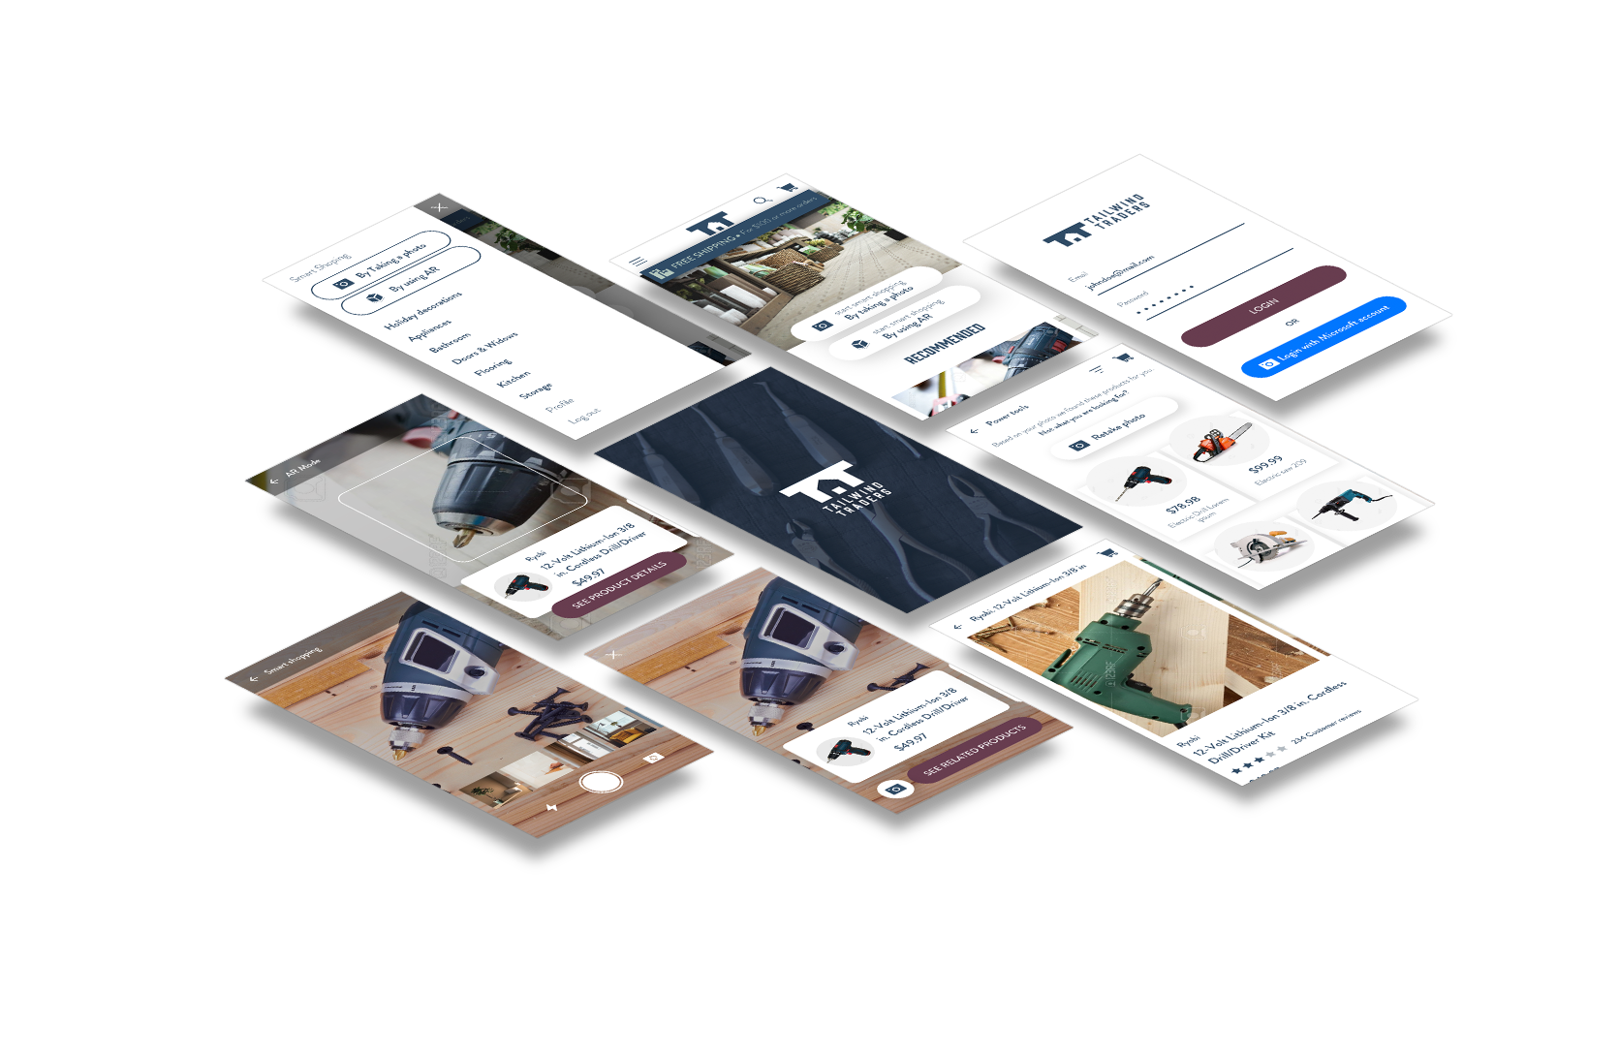
Xamarin.Forms 4.0 Themes
Solving “100” Little Paper Cuts
Essentials
Shell
Visual
CollectionView
CarouselView

Slide 4
F100: Addressing the Little Things
http://bit.ly/forms-100
Entry/Editor
IsSpellCheckEnabled
MaxLength
DetectReadingOrderFromContent (UWP)
Text prediction options
Autocapitalization
AutoResizable Editor
ButtonType for return button
Position and Color of caret
Placeholder color
Label
Bindable Spans
Commandable Spans, Span Gestures
LineHeight
ListView
Full width separators
SelectionMode
SearchBar IsSpellCheckEnabled
ImeOptions
DesignModeEnabled
Android Bottom Tabs
WebView mixed content (Android)
WebView evaluate javascript
Binding Mode OneTime
ProgressBar colors
Switch colors
Slider colors
Hide scroll bars
Button AccessKey
TabbedPage Icons (UWP)
Drop Shadows (iOS/UWP)
App DI Container Hooks
Button Padding
Page TitleView
BoxView rounded corners
WKWebView for iOS
Coming Soon
Label MaxLines
Entry Read-Only
ImageButton
GIF Support
Button and Label Parity
PinsSource on Forms.Map
WebView Zoom Controls (Android)
Help Wanted
Rounded Corners
Rounded Image
ProgressBar.Height
InkWell Ripple Effect
Size WebView to Content
Floating Action Button
Android Theme Capitalization override

Slide 5
Xamarin Essentials A kit of essential cross platform APIs for your mobile apps – Native Android, Native iOS or Forms
Accelerometer
App Information
Barometer
Battery State
Clipboard
Compass
Connectivity
Data Transfer
Device Information
Email
Geocoding
Geolocation
Gyroscope
Magnometer
Open Browser
Phone Dialer
Preferences
Screen Lock
Secure Storage
Shake Detection
SMS
Text to Speech
Version Tracking
Vibrate
Much, much more!

Slide 6
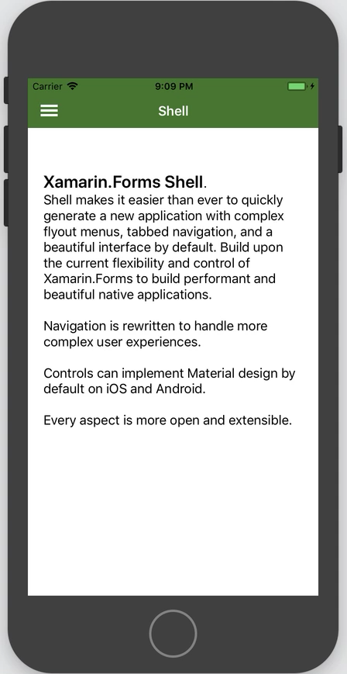
Xamarin.Forms Shell
Simplicity! Shell sets up your navigation with platform defaults
Flyout Menu
Bottom Tabs
Top Tabs
Just add your ContentPages
URL routed navigation, deep linking
Back navigation handling
Integrated Search handler
DataTemplates
Performance – Reduced Overdraw
Supports Android and iOS
Supports Visual to achieve consistent UI across Android & iOS

Slide 7
Shell Types
3 Levels of Content
ShellItem > ShellSection > ShellContent
Default as Flyout Menu > Bottom Tabs > Top Tabs
Because these are the existing UI patterns on Android and iOS
Shell would render differently on other platforms where these are not the preferred patterns

Slide 8
Example Shell
<Shell xmlns=…>
<Shell.Resources>
<ResourceDictionary Source="Styles/Global.xaml"/>
</Shell.Resources>
<ShellItem Route="main" Title="Home">
<ShellSection Route="home" Title=“Home”>
<ShellContent ContentTemplate="{DataTemplate local:MainPage}" />
</ShellSection>
<ShellSection Route="activity" Title="Activity">
<ShellContent Route="shared" Title="Shared" ContentTemplate="{DataTemplate local:ActivityPage}" />
<ShellContent Route="notifications" Title="Notifications" ContentTemplate="{DataTemplate local:NotificationsPage}" />
</ShellSection>
<ShellSection Route="updates" Title="Updates">
<ShellContent ContentTemplate="{DataTemplate local:UpdatesPage}" />
</ShellSection>
</ShellItem>
</Shell>

Slide 9
Level 1 – Flyout Menu Item
<Shell xmlns=…>
<Shell.Resources>
<ResourceDictionary Source="Styles/Global.xaml"/>
</Shell.Resources>
<ShellItem Route="main" Title="Home">
<ShellSection Route="home" Title="Home">
<ShellContent ContentTemplate="{DataTemplate local:MainPage}" />
</ShellSection>
<ShellSection Route="activity" Title="Activity">
<ShellContent Route="shared" Title="Shared" ContentTemplate="{DataTemplate local:ActivityPage}" />
<ShellContent Route="notifications" Title="Notifications" ContentTemplate="{DataTemplate local:NotificationsPage}" />
</ShellSection>
<ShellSection Route="updates" Title="Updates">
<ShellContent ContentTemplate="{DataTemplate local:UpdatesPage}" />
</ShellSection>
</ShellItem>
</Shell>
Note: To hide the Flyout menu altogether set FlyoutBehavior=“Disabled”

Slide 10
Level 2 – Bottom Tabs
<Shell xmlns=…>
<Shell.Resources>
<ResourceDictionary Source="Styles/Global.xaml"/>
</Shell.Resources>
<ShellItem Route="main" Title="Home">
<ShellSection Route="home" Title="Home">
<ShellContent ContentTemplate="{DataTemplate local:MainPage}" />
</ShellSection>
<ShellSection Route="activity" Title="Activity">
<ShellContent Route="shared" Title="Shared" ContentTemplate="{DataTemplate local:ActivityPage}" />
<ShellContent Route="notifications" Title="Notifications" ContentTemplate="{DataTemplate local:NotificationsPage}" />
</ShellSection>
<ShellSection Route="updates" Title="Updates">
<ShellContent ContentTemplate="{DataTemplate local:UpdatesPage}" />
</ShellSection>
</ShellItem>
</Shell>

Slide 11
Level 3 – Top Tabs
<Shell xmlns=…>
<Shell.Resources>
<ResourceDictionary Source="Styles/Global.xaml"/>
</Shell.Resources>
<ShellItem Route="main" Title="Home">
<ShellSection Route="home" Title="Home">
<ShellContent ContentTemplate="{DataTemplate local:MainPage}" />
</ShellSection>
<ShellSection Route="activity" Title="Activity">
<ShellContent Route="shared" Title="Shared" ContentTemplate="{DataTemplate local:ActivityPage}" />
<ShellContent Route="notifications" Title="Notifications" ContentTemplate="{DataTemplate local:NotificationsPage}" />
</ShellSection>
<ShellSection Route="updates" Title="Updates">
<ShellContent ContentTemplate="{DataTemplate local:UpdatesPage}" />
</ShellSection>
</ShellItem>
</Shell>

Slide 12
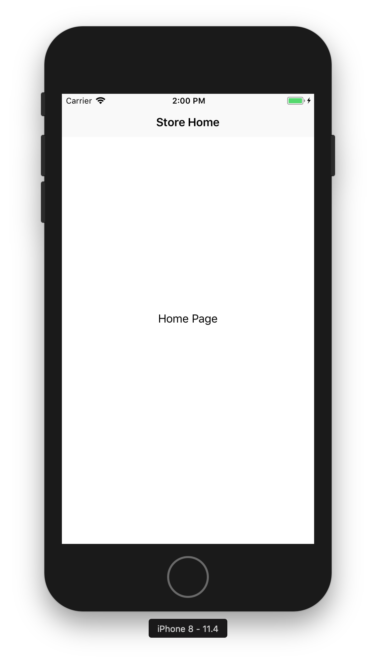
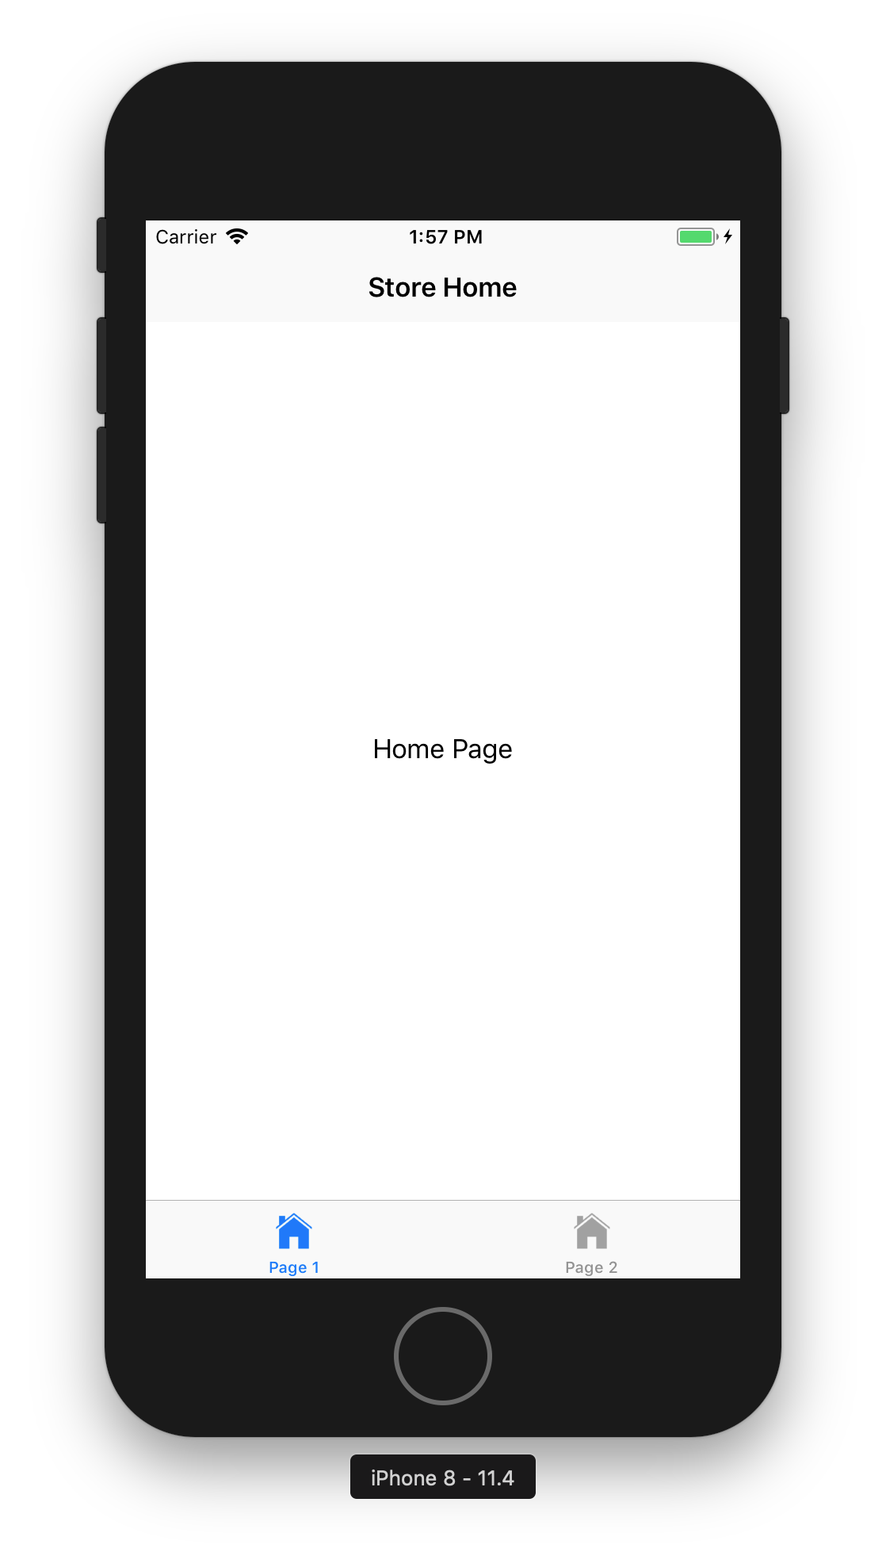
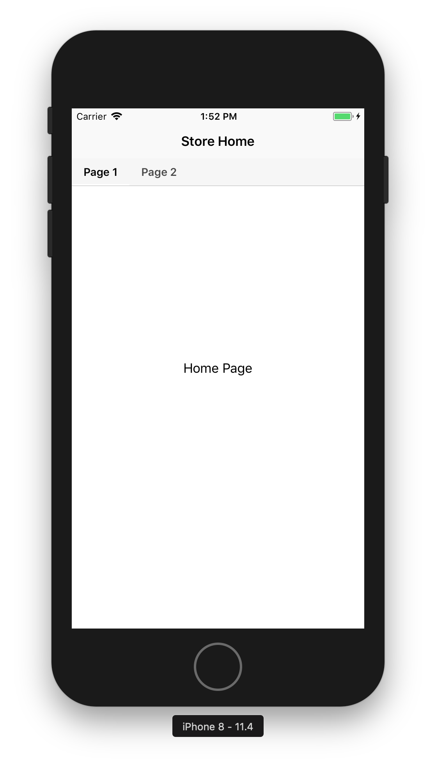
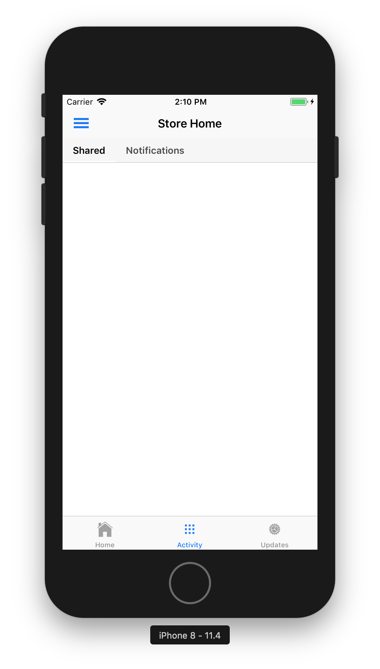
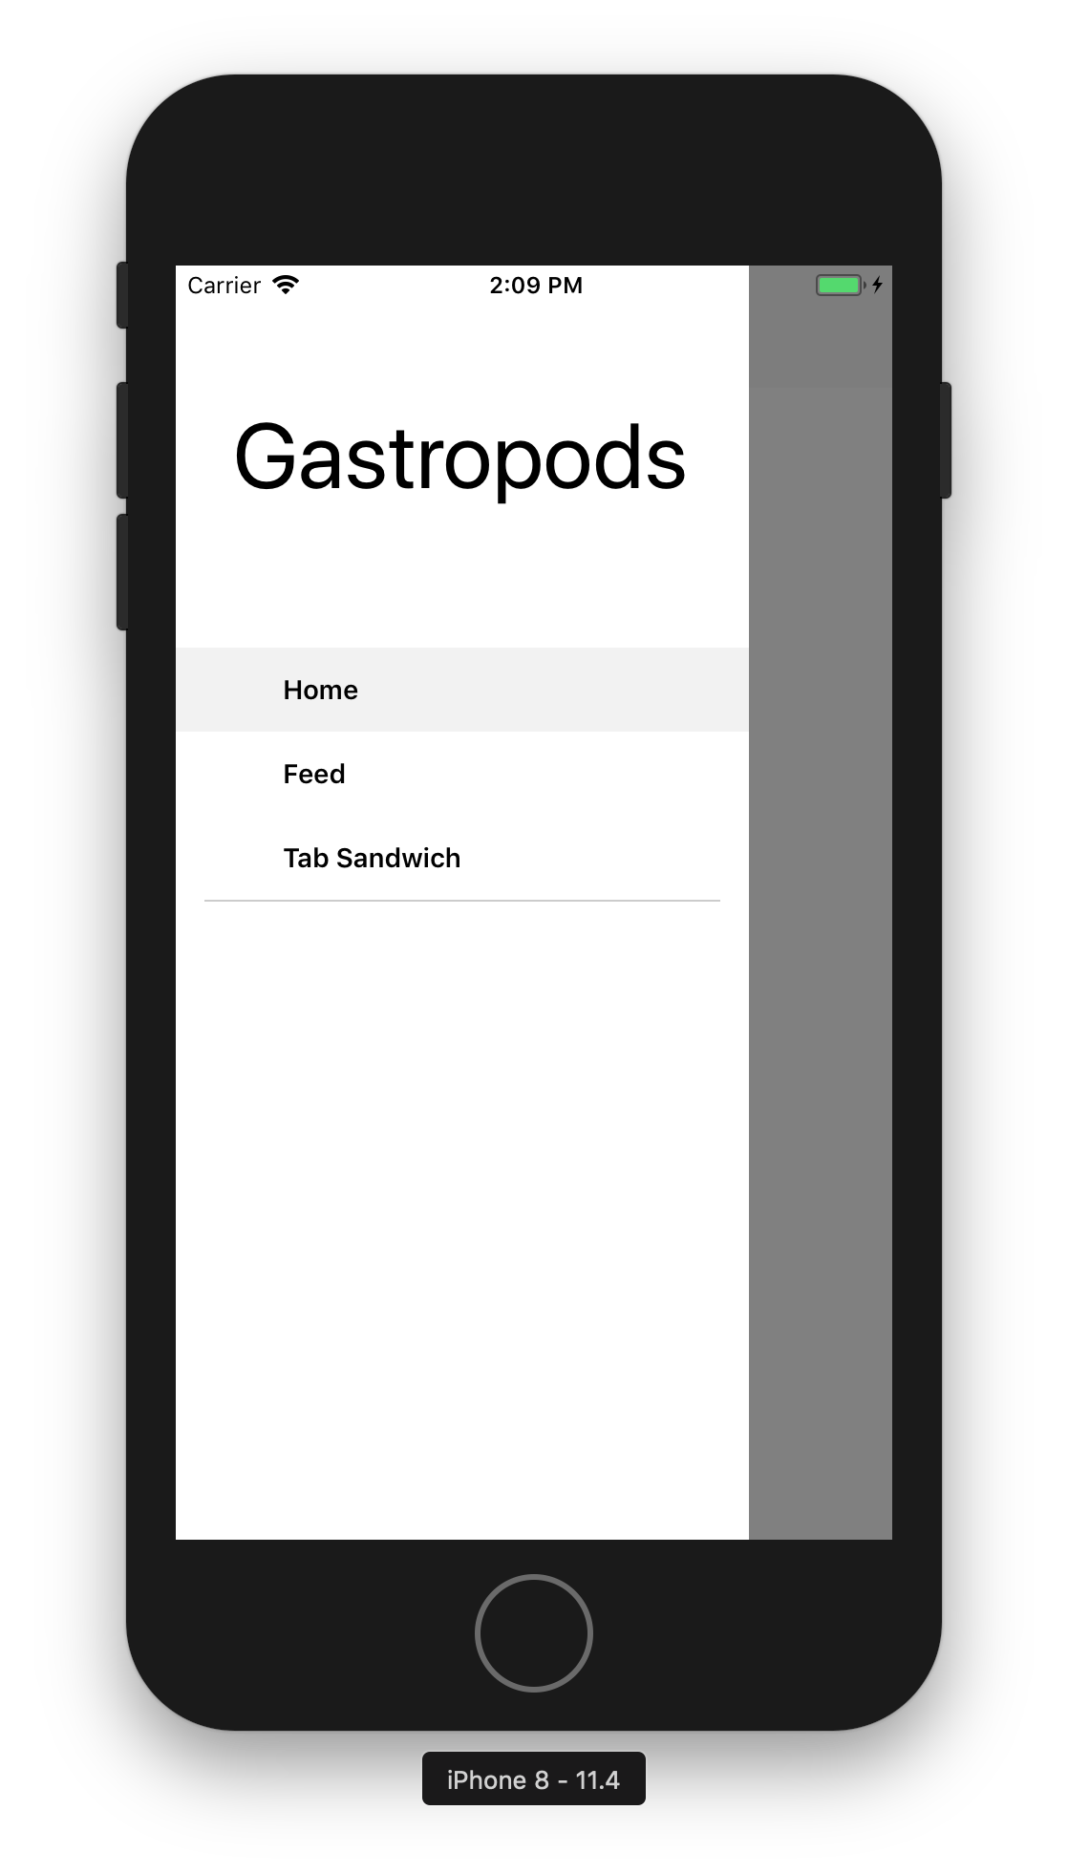
Supported Navigation UI Patterns in Shell
1 Page
Bottom Tabs
Top Tabs
Bottom & Top Tabs
Flyout

Slide 13
Feedback Driven Development
Refactoring Shell based on Feedback
Why is everything prefixed with Shell?
What’s the different between a ShellItem, ShellSection, and ShellContent?
And a MenuItem is what?
Why should the concept of describing content (I have 3 pages) be at odds with achieving a UI design (bottom tabs)?
Coming Soon
Item replaces existing Shell items
ShellItem, ShellSection, ShellContent, and MenuItem
Nesting content and Shell
Renders the appropriate menus for you
Explicitly set the navigation behavior you desire

Slide 14
http://bit.ly/forms-shell-survey
We need your feedback!

Slide 15
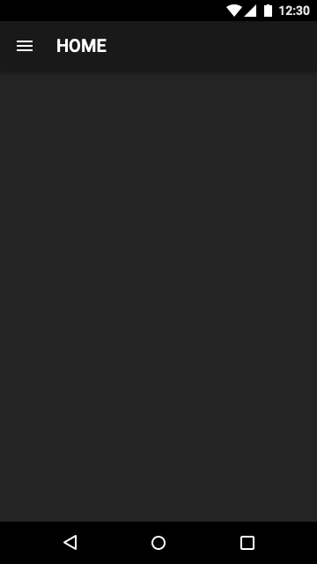
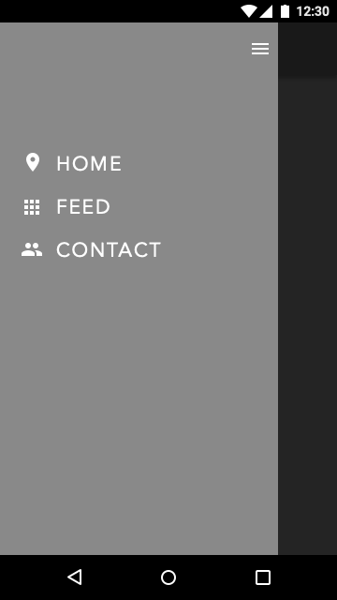
Predict The UI
<Shell xmlns="http://xamarin.com/schemas/2014/forms"
xmlns:x="http://schemas.microsoft.com/winfx/2009/xaml"
xmlns:local="clr-namespace:MyApp"
Route="root"
RouteHost="xamarin.com"
RouteScheme="app"
x:Class="MyApp.AppShell">
<Item Icon="home.png"
Title="Home"
ContentTemplate="{DataTemplate local:MainPage}"/>
<Item Icon="feed.png"
Title="Feed"
ContentTemplate="{DataTemplate local:FeedPage}"/>
<Item Icon="contact.png"
Title="Contact”
ContentTemplate="{DataTemplate local:ContactPage}"/>
</Shell>

Slide 16
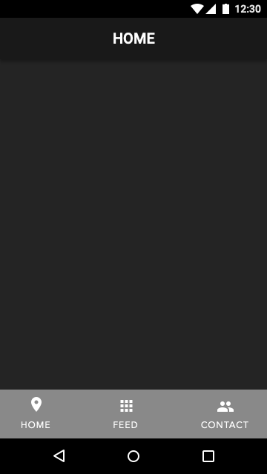
Predict The UI
<Shell xmlns="http://xamarin.com/schemas/2014/forms"
xmlns:x="http://schemas.microsoft.com/winfx/2009/xaml"
xmlns:local="clr-namespace:MyApp"
Route="root"
RouteHost="xamarin.com"
RouteScheme="app"
FlyoutBehavior="Disabled"
x:Class="MyApp.AppShell">
<Item>
<Item Icon="home.png"
Title="Home"
ContentTemplate="{DataTemplate local:MainPage}"/>
<Item Icon="feed.png"
Title="Feed"
ContentTemplate="{DataTemplate local:FeedPage}"/>
<Item Icon="contact.png"
Title="Contact”
ContentTemplate="{DataTemplate local:ContactPage}"/>
</Item>
</Shell>

Slide 17
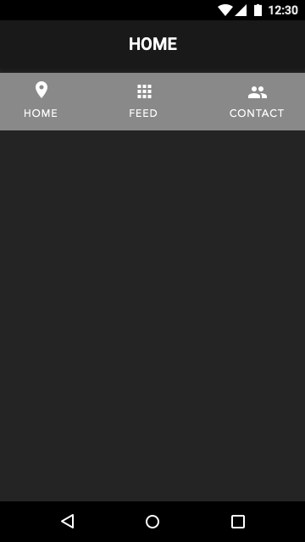
Predict The UI
<Shell xmlns="http://xamarin.com/schemas/2014/forms"
xmlns:x="http://schemas.microsoft.com/winfx/2009/xaml"
xmlns:local="clr-namespace:MyApp"
Route="root"
RouteHost="xamarin.com"
RouteScheme="app"
FlyoutBehavior="Disabled"
x:Class="MyApp.AppShell">
<Item>
<Item>
<Item Icon="home.png"
Title="Home"
ContentTemplate="{DataTemplate local:MainPage}"/>
<Item Icon="feed.png"
Title="Feed"
ContentTemplate="{DataTemplate local:FeedPage}"/>
<Item Icon="contact.png"
Title="Contact”
ContentTemplate="{DataTemplate local:ContactPage}"/>
</Item>
</Item>
</Shell>

Slide 18
Override Shell Navigation Behavior
<Shell xmlns="http://xamarin.com/schemas/2014/forms"
xmlns:x="http://schemas.microsoft.com/winfx/2009/xaml"
xmlns:local="clr-namespace:MyApp"
Route="root"
RouteHost="xamarin.com"
RouteScheme="app"
FlyoutBehavior="Disabled"
x:Class="MyApp.AppShell">
<Shell.NavigationBehavior>
<TopTabs />
</Shell.NavigationBehavior>
<Item Icon="home.png"
Title="Home"
ContentTemplate="{DataTemplate local:MainPage}"/>
<Item Icon="feed.png"
Title="Feed"
ContentTemplate="{DataTemplate local:FeedPage}"/>
<Item Icon="contact.png"
Title="Contact”
ContentTemplate="{DataTemplate local:ContactPage}"/>
</Shell>

Slide 19
Override Shell Navigation Behavior
<Shell xmlns="http://xamarin.com/schemas/2014/forms"
xmlns:x="http://schemas.microsoft.com/winfx/2009/xaml"
xmlns:local="clr-namespace:MyApp"
Route="root"
RouteHost="xamarin.com"
RouteScheme="app"
FlyoutBehavior="Disabled"
x:Class="MyApp.AppShell">
<Shell.NavigationBehavior>
<TopTabs />
</Shell.NavigationBehavior>
<Item Icon="home.png"
Title="Home"
ContentTemplate="{DataTemplate local:MainPage}"/>
<Item Icon="feed.png"
Title="Feed"
ContentTemplate="{DataTemplate local:FeedPage}"/>
<Item Icon="contact.png"
Title="Contact”
ContentTemplate="{DataTemplate local:ContactPage}"/>
</Shell>

Slide 20
Navigation
Navigation may be performed programmatically via routes
Absolute URIs
Relative URIs
QueryString Parameters mapped to ContentPage or BindingContext (ViewModel) properties
Shell
.CurrentShell
.GoToAsync("/takephoto?payload=4.0", true);
[QueryProperty("Payload", "payload")] public class CameraViewModel : INotifyPropertyChanged {
public string Payload { get { return _payload; } set { SetAndRaisePropertyChanged(ref _payload, value); } }

Slide 21
Navigation Shell
<Shell xmlns=…>
<Shell.Resources>
<ResourceDictionary Source="Styles/Global.xaml"/>
</Shell.Resources>
<ShellItem Route="main" Title="Home">
<ShellSection Route="home" Title=“Home”>
<ShellContent ContentTemplate="{DataTemplate local:MainPage}" />
</ShellSection>
<ShellSection Route="activity" Title="Activity">
<ShellContent Route="shared" Title="Shared" ContentTemplate="{DataTemplate local:ActivityPage}" />
<ShellContent Route="notifications" Title="Notifications" ContentTemplate="{DataTemplate local:NotificationsPage}" />
</ShellSection>
<ShellSection Route="updates" Title="Updates">
<ShellContent ContentTemplate="{DataTemplate local:UpdatesPage}" />
</ShellSection>
</ShellItem>
</Shell>

Slide 22
Navigation
Routing.RegisterRoute("notifications", typeof(NotificationsPage));
var state = new ShellNavigationState("http://www.xamarin.com/gastropod/tabsandwich/activity/notifications");
Shell.CurrentShell.GoToAsync(state, true);
// or
Shell.CurrentShell.GoToAsync("///gastropod/tabsandwich/activity/notifications");
// or
Shell.CurrentShell.GoToAsync("/notifications");

Slide 23
Example: Tailwind Traders
https://github.com/Microsoft/TailwindTraders-Mobile/

Slide 24
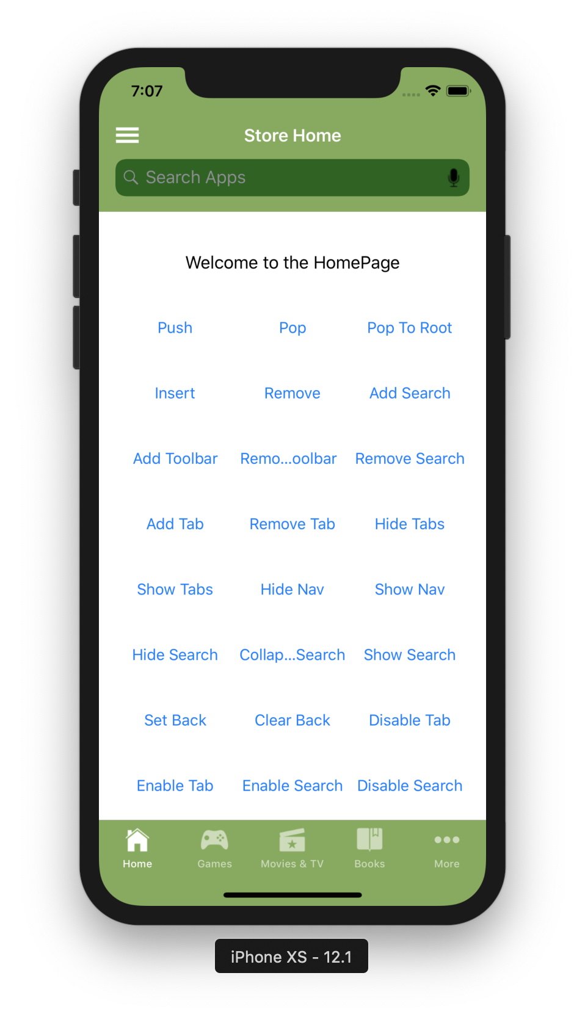
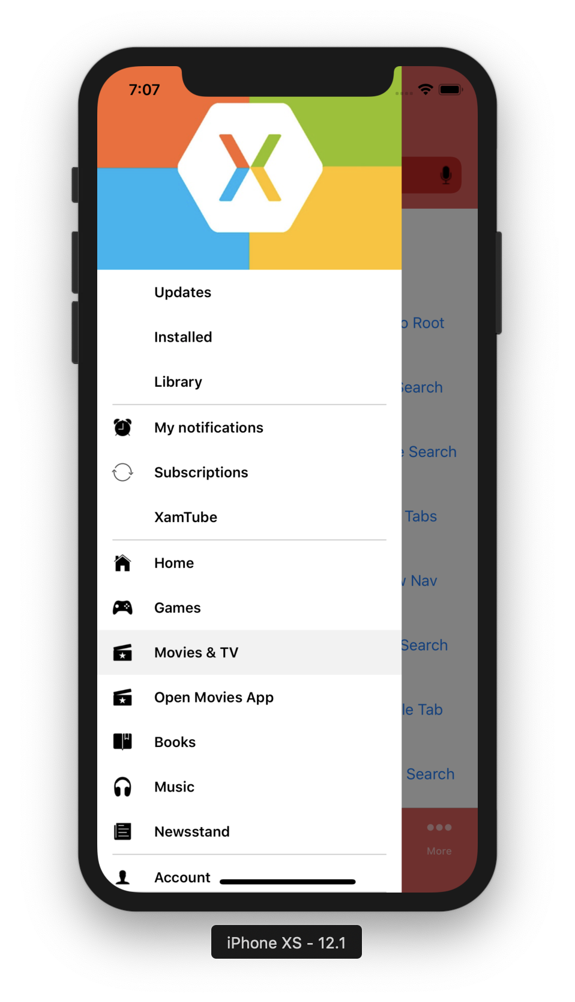
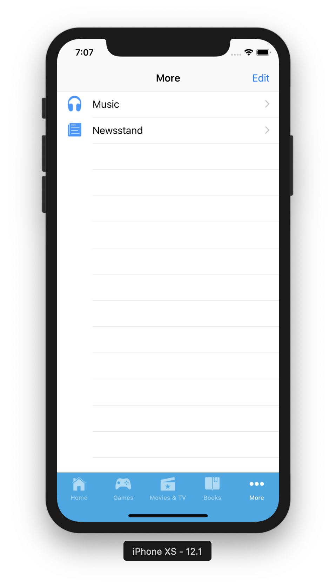
Example: Shell Gallery
https://github.com/davidortinau/ShellGallery

Slide 25
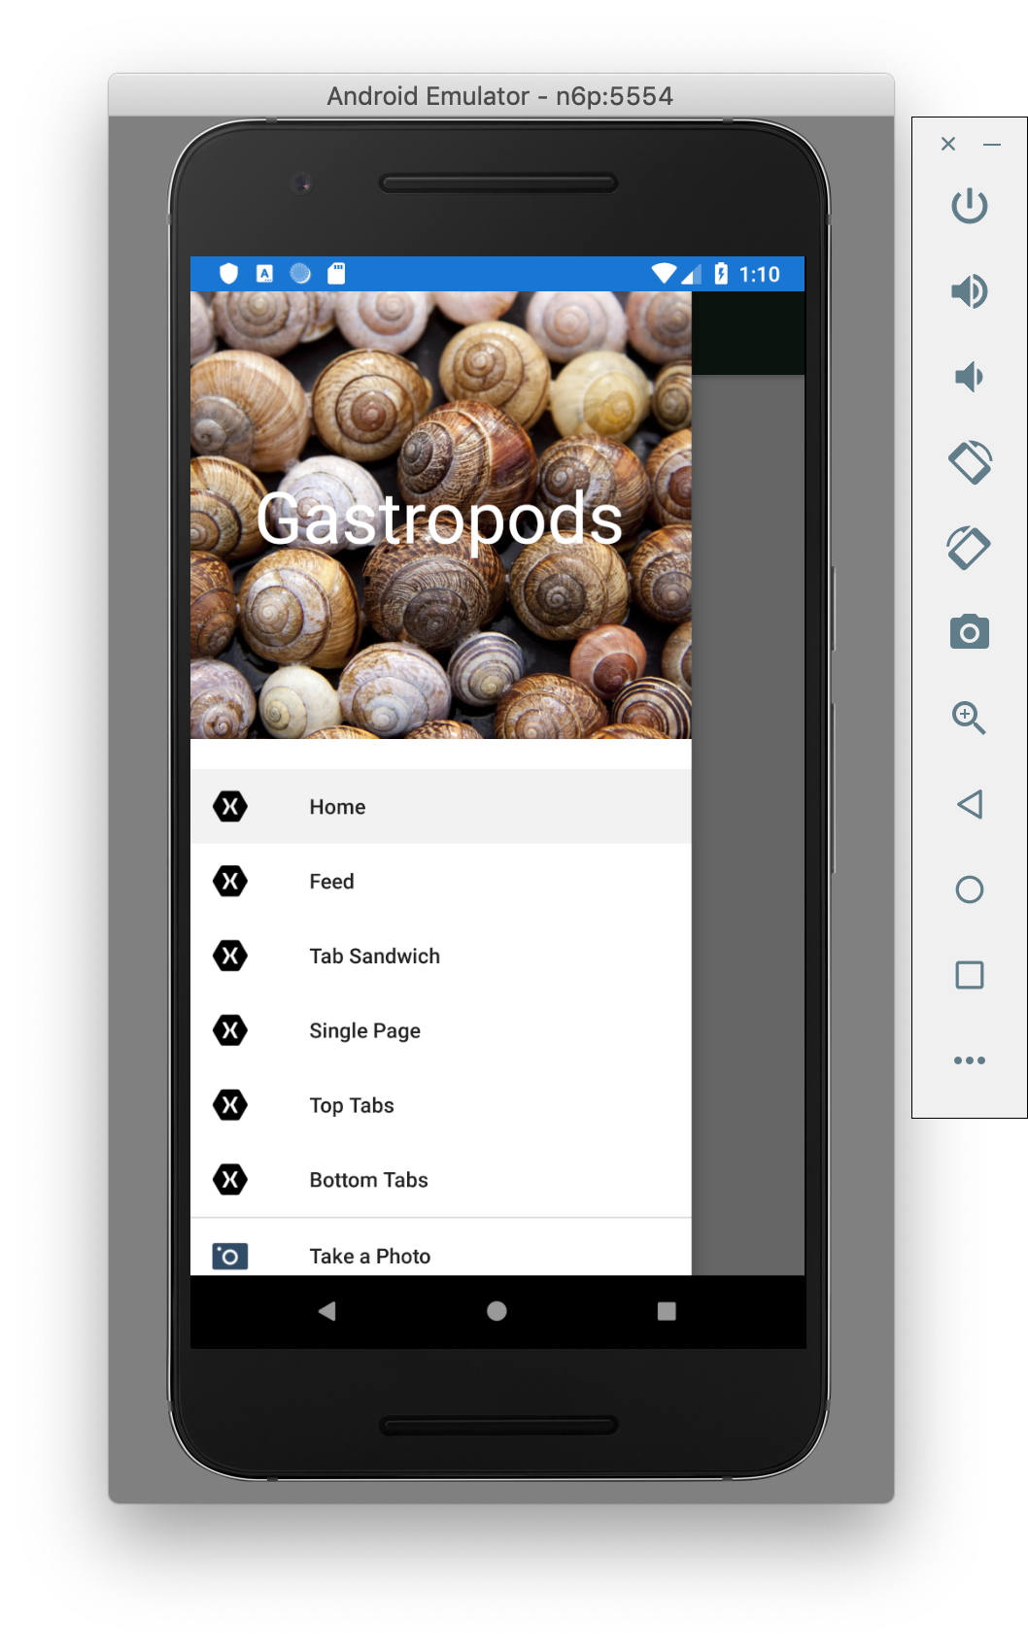
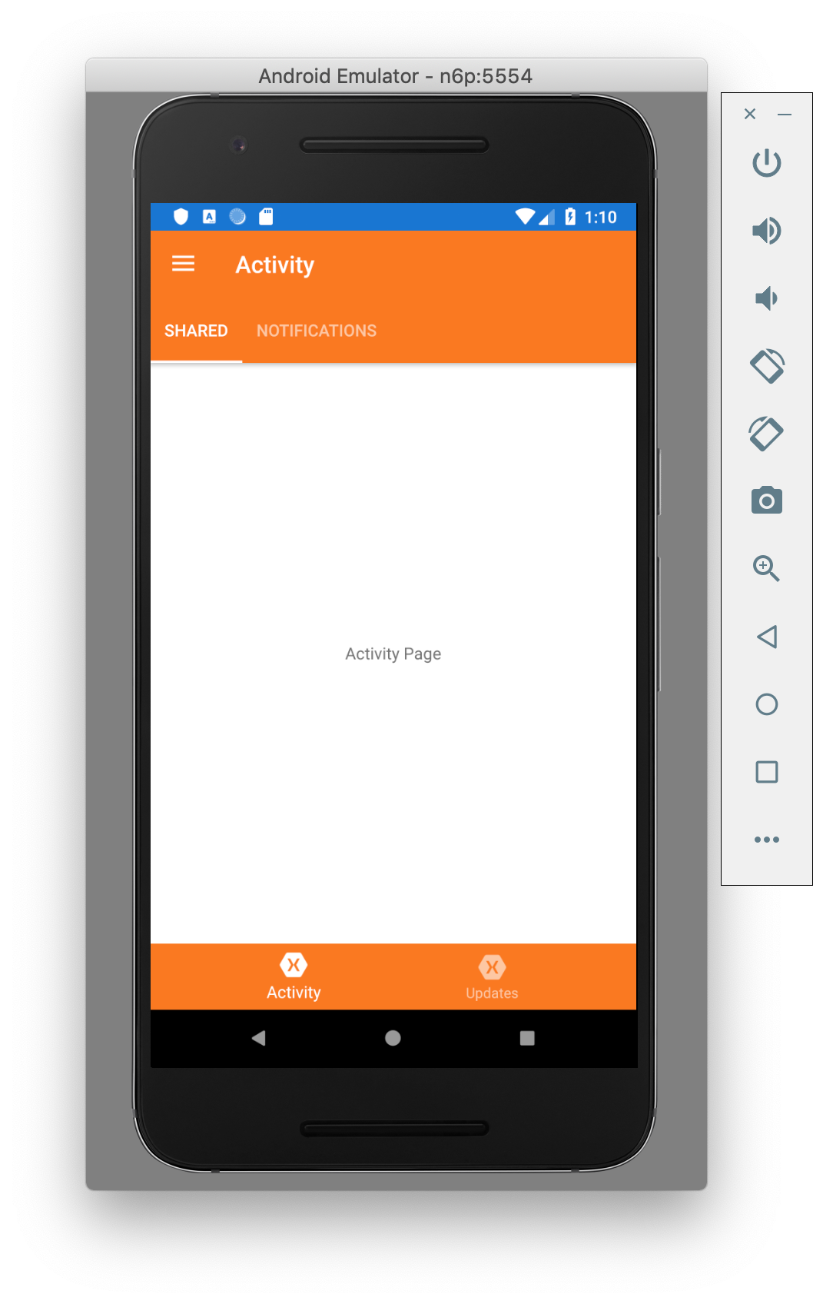
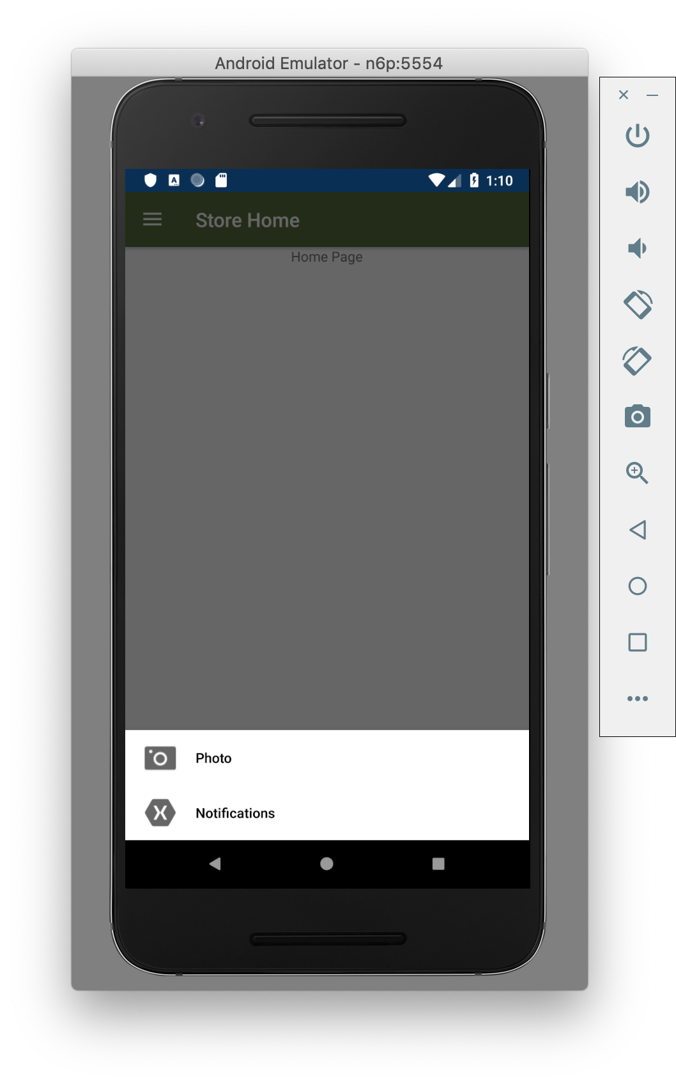
Example: Gastropods
https://github.com/davidortinau/Gastropods

Slide 26
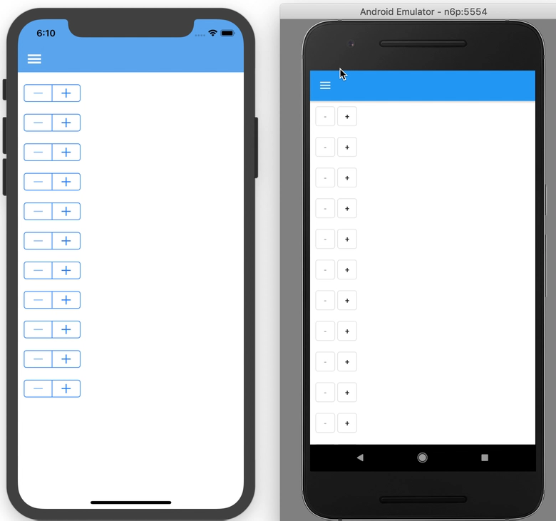
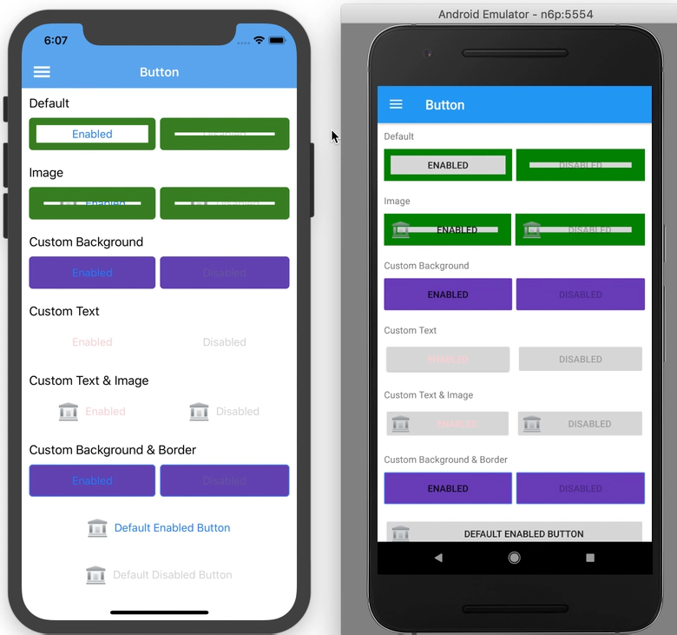
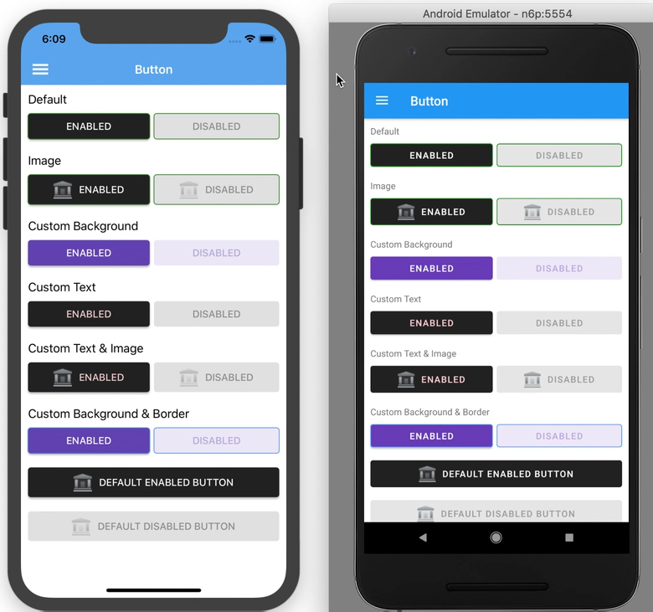
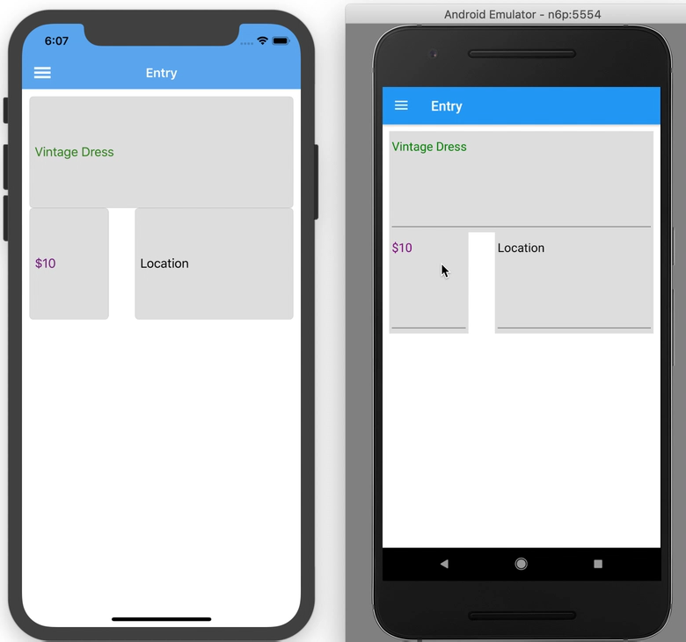
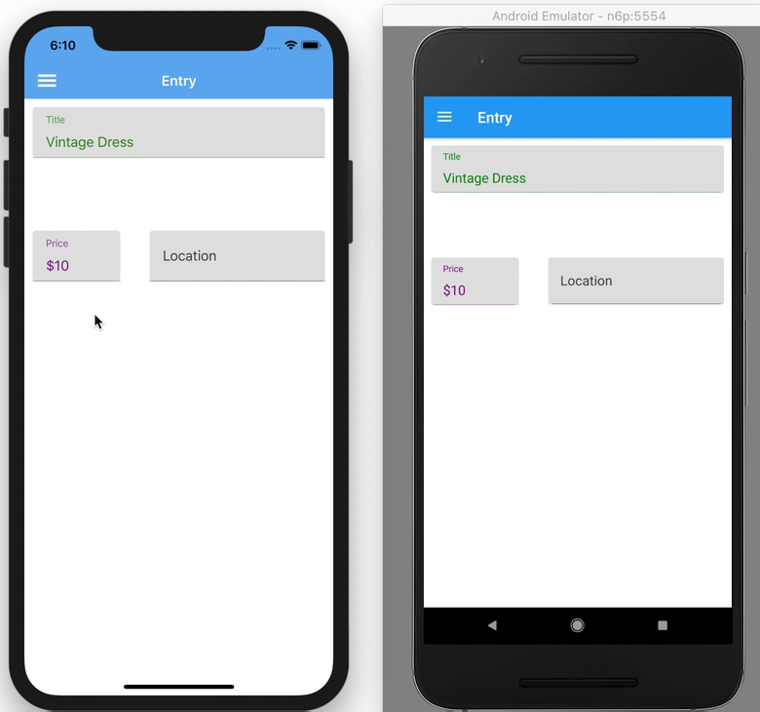
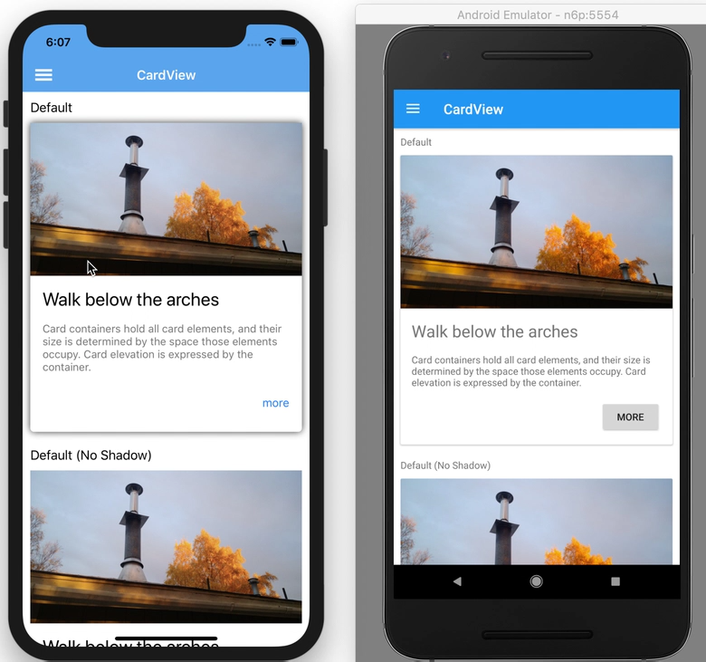
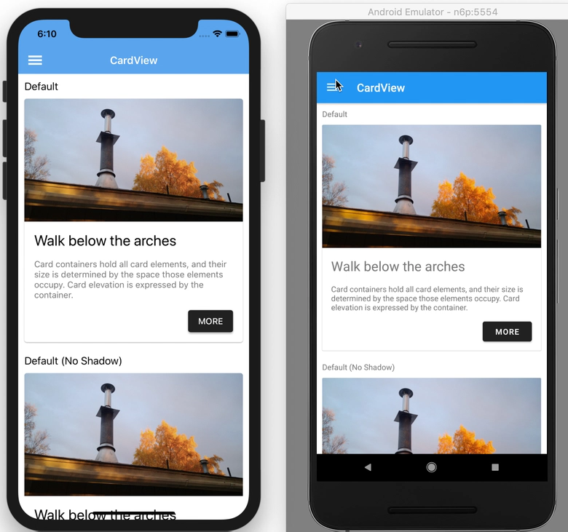
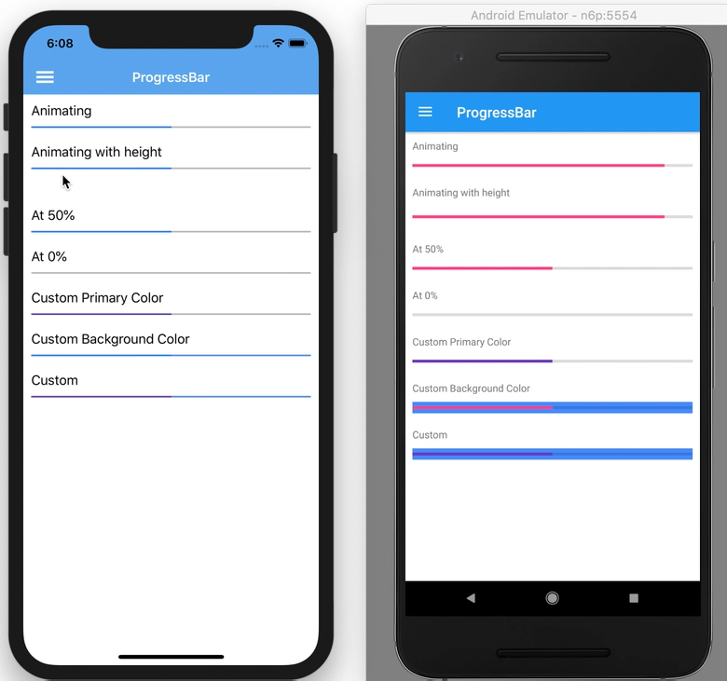
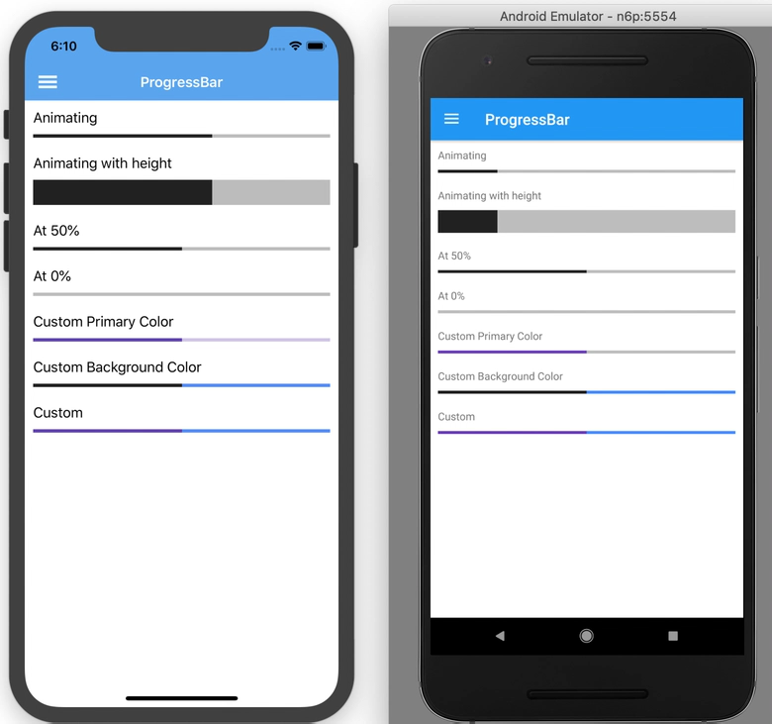
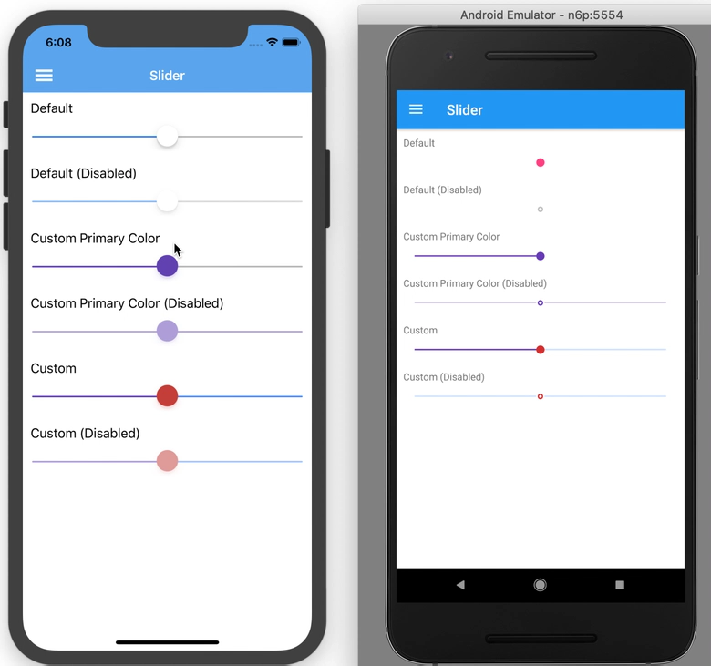

Visual
<ContentPage
Visual="Material" ...>
<Entry
Visual="Material" ...>
Consistent UI across Android and iOS
Not just styles, but modified renderers to implement Material design look & behavior
Requires a New NuGet
Xamarin.Forms.Visual.Material
Xamarin.iOS.MaterialComponents
Add FormsMaterial.Init() in AppDelegate.cs.
Forms.SetFlags(“Visual_Experimental”)

Slide 27
https://github.com/davidortinau/VisualChallenge
Try and create just a single page
Then send it back as a PR

Slide 28
CollectionView
Layouts: Vertical, Horizontal, Grid, and Custom
EmptyView
Single and Multiple Selection modes
No more ViewCell wrappers
Snap Points
Header and Footer templates
RTL
Specification: http://bit.ly/cv-spec
Progress: http://bit.ly/cv-progress

Slide 29
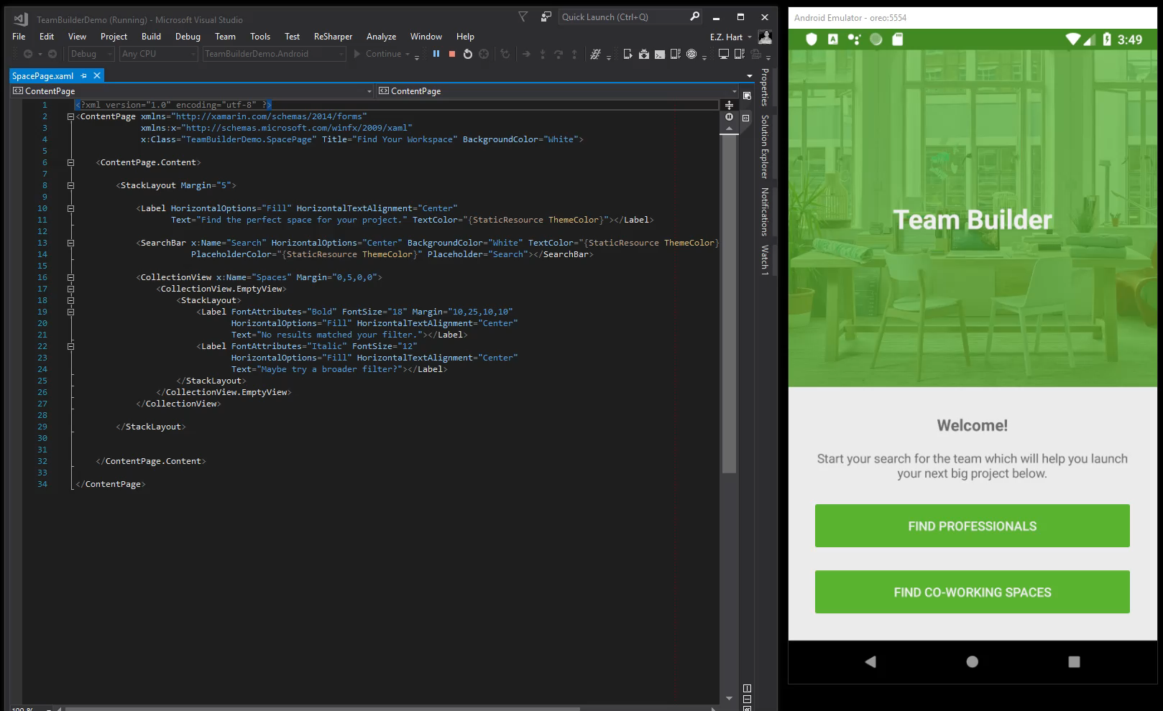
CollectionView

Slide 30
CollectionView XAML
<CollectionView x:Name="Spaces" Margin="0,5,0,0">
<CollectionView.Layout>
<GridLayout Span="2" Orientation="Vertical"/>
</CollectionView.Layout>
<CollectionView.EmptyView>
<StackLayout>
<Label FontAttributes="Bold" FontSize="18" Margin="10,25,10,10"
HorizontalOptions="Fill" HorizontalTextAlignment="Center"
Text="No results matched your filter."></Label>
<Label FontAttributes="Italic" FontSize="12"
HorizontalOptions="Fill" HorizontalTextAlignment="Center"
Text="Maybe try a broader filter?"></Label>
</StackLayout>
</CollectionView.EmptyView>
</CollectionView>

Slide 31
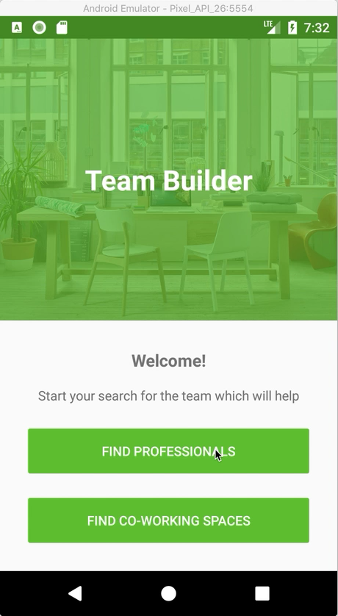
CarouselView
Specification:
http://bit.ly/spec-carousel

Slide 32
CarouselView XAML
<CarouselView x:Name="CarouselView">
<CarouselView.ItemTemplate>
<DataTemplate>
<local:Card />
</DataTemplate>
</CarouselView.ItemTemplate>
</CarouselView>

Slide 33
https://github.com/davidortinau/VisualChallenge
Thank You!

